Slide 1
DATA SCIENCE
10 WEEK PART TIME COURSE
Recommendation Engines

Slide 2
AGENDA
What are Recommendations?
What is Content-Based Filtering?
What is Collaborative Filtering?
Similarity scoring
Rated similarity

Slide 3
WHAT ARE RECOMMENDATION ENGINES?
DATA SCIENCE PART TIME COURSE

Slide 4




RECOMMENDATION ENGINES
Recommendation engines aims to match users to things (movies, songs, items, events, etc) they might enjoy but have not yet tried.
The rating is produced by analysing other user/item ratings (and sometimes item characteristics) to provide personalised recommendations to users.

Slide 5
RECOMMENDATION ENGINES
There are two general approaches to the design:
In content-based filtering, items are mapped into a feature space, and recommendations depend on item characteristics.
In contrast, the only data under consideration in collaborative filtering are user-item ratings, and recommendations depend on user preferences.
But… as usual, hybrid / ensemble models of both outperform either on their own.

Slide 6
CONTENT-BASED FILTERING
DATA SCIENCE PART TIME COURSE

Slide 7
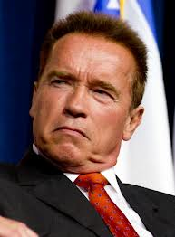


CONTENT-BASED FILTERING
Looking at attributes of an item, you then make recommendations based on how similar those items are.
You liked Predator with Arnold Schwarzenegger you might also like The Terminator (because Arnie’s in that too).

Slide 8
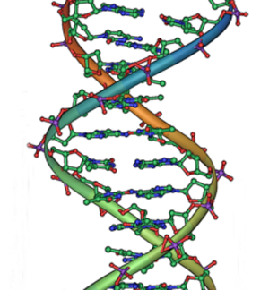
CONTENT-BASED FILTERING
Pandora is an example of Content-Based filtering. A massive taxonomy of musical information. Trained musical analysts identify over 450 musical characteristics (lookup the Music Genome Project).

Slide 9
CONTENT-BASED FILTERING WITH RATINGS
Map each item into a feature space.
e.g. large number of True / False columns
Users rate what they like
Preferably on a numeric scale
Regress the user rating against the feature columns of the item, take the best

Slide 10
CONTENT-BASED FILTERING WITHOUT RATINGS
Map each item into a feature space.
e.g. large number of True / False columns
Capture like / didn’t like
Can be bought / hasn’t bought
But is “hasn’t bought” = “doesn’t want” or “hasn’t bought yet”?
K-Nearest neighbours
Regress “like / didn’t like” based on similarity
Or, wander through points near the “liked” points

Slide 11
CONTENT-BASED FILTERING
Content-based filtering has some difficulties:
Must map items into a feature space
Recommendations are limited in scope (items must be similar to each other)
Hard to create cross-content recommendations (eg books/music films...this would require comparing elements from different feature spaces)

Slide 12
Example: matching listeners to songs
DATA SCIENCE PART TIME COURSE

Slide 13
COLLABORATIVE FILTERING
DATA SCIENCE PART TIME COURSE

Slide 14
Which do you have?
Look for users that are similar
Have bought similar items and rated them
Use their data to predict this user’s response
(If you have more items than you have user data)
Look for items that are similar
Have been bought by the same people
Use the other item’s data to product this item’s attractiveness
(If you have more user data than you have items)

Slide 15
SIMILARITY SCORES
DATA SCIENCE PART TIME COURSE

Slide 16
When you don’t have ratings
All you have is similarity
Jaccard
Amazon’s algorithm

Slide 17
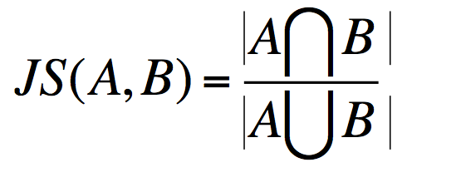
JACCARD SIMILARITY
Jaccard Similarity:
Defines similarity between two sets of objects

Slide 18
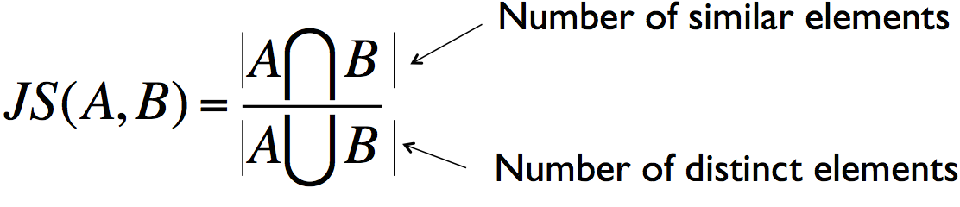
JACCARD SIMILARITY
Jaccard Similarity:
Defines similarity between two sets of objects

Slide 19
JACCARD SIMILARITY
JS ({1, 2, 3}, {2,3,4}) = {2,3} / {1,2,3,4}
= 2/4
= 1/2

Slide 20
JACCARD SIMILARITY
User one: {“Target”,“Banana Republic”,“Old Navy”}
User two: {“Banana Republic”,“Gap”,“Kohl’s”}
JS (User one, User two) =

Slide 21
JACCARD SIMILARITY
User one: {“Target”,“Banana Republic”,“Old Navy”}
User two: {“Banana Republic”,“Gap”,“Kohl’s”}
JS (User one, User two) = 1/5

Slide 22
Amazon item-item (cosine) patented algorithm
For each pair of items
How many times has a user bought both of them?
Divide that by the square-root of the number of users who bought the first item
Divide again by the square-root of the number of users who bought the second item
When a user browses for an item, find the other products with the highest scores

Slide 23
Summary
Jaccard similarity requires similar popularity
Amazon cosine handles this better

Slide 24
Example: brand affinity
DATA SCIENCE PART TIME COURSE

Slide 25
RATED COLLABORATIVE FILTERING
DATA SCIENCE PART TIME COURSE

Slide 26
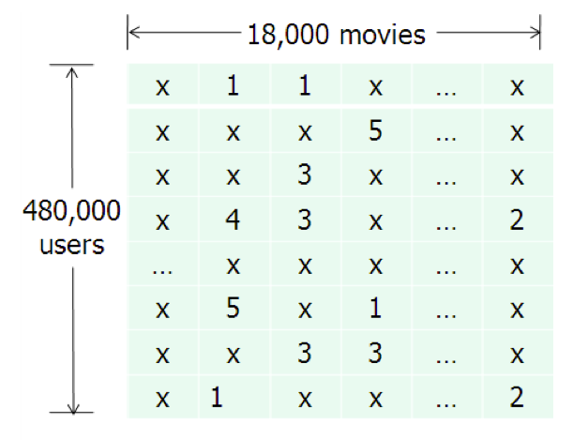
COLLABORATIVE FILTERING
This will be the general form of the data we analyse for collaborative filtering.
The method relies on previous user-item ratings (or feedback).

Slide 27
LINEAR (OR OTHER) MODEL
Find users who have reviewed both movies A and B
Build a linear (?) model to predict review scores of B based on the review scores of A
Repeat for other pairs of movies
Recommend the movie with the strongest correlation

Slide 28
Slope One Collaborative Filtering
If there is a relationship between two movies, it is likely to be coef_=1 anyway
So, store the mean review score of A and the mean review score of B
If someone reviews A with a score of “a”, then predict that they will review B with a score of (a – A.mean()) + B.mean()
If they have also reviewed C, then predict (c – C.mean()) + B.mean())
Combine these to predict B.mean() + (1/2)*(a-A.mean())+(c-C.mean())
Or instead of (1/2), weight according to the number of review pairs

Slide 29
Example: movie reviews
DATA SCIENCE PART TIME COURSE

Slide 30
OTHER CONSIDERATIONS
DATA SCIENCE PART TIME COURSE

Slide 31
COLLABORATIVE FILTERING
Collaborative filtering is susceptible to the Cold Start problem.
What happens if we don’t have any (or enough) reviews?

Slide 32
COLLABORATIVE FILTERING
Collaborative filtering is susceptible to the Cold Start problem.
What happens if we don’t have any (or enough) reviews?
Until users rate several items, we don’t know anything about their preferences.
We can get around this by enhancing our recommendations using implicit feedback, which may include things like item browsing behaviour, search patterns, purchase history, etc. Or by using a hybrid model.

Slide 33
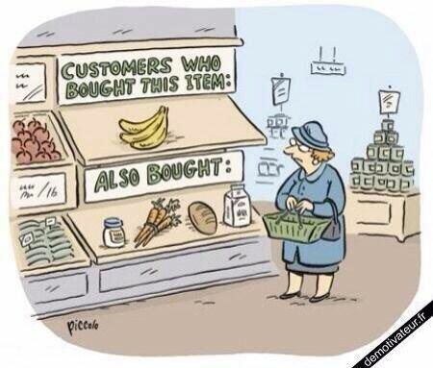
LAB
DATA SCIENCE PART TIME COURSE

Slide 34
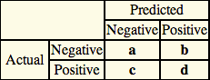
MEASURING ERROR
Accuracy = Correct Recommendations / Total Possible Recommendations
= (a + d )/(a + b +c + d)
Precision = Correctly Recommended Items / Total Recommended Items
= d / (b + d)
Recall = Correctly Recommended Items / Total Useful Recommended Items
= d / (c + d)
Precision ~1 means the algorithm returned more relevant results than irrelevant.
Recall ~1 means that an algorithm returned most of the relevant results.

Slide 35

EXPLICIT VS IMPLICIT DATA
Explicit data is when you ask the user to rate something, e.g. 1-5 star rating for a movie
Implicit data is when you observe a users behaviour and record

Slide 36
ALGORITHMS
Alternating Least Squares (ALS)
Stochastic Gradient Descent (SGD)
Singular Value Decomposition (SVD)
Factorization Machine (FM)
Collaborative Less is More Filtering (CLiMF)

Slide 37
MODEL OBJECTIVES
Ranking
Freshness
Diversity
Social Recommendations
Context Aware Recommendations
Hybrid Models (Combining Content based filtering and Collaborative filtering)
Model Objectives (what are you trying to optimise)
Sequences?

